Slide 1
Flow5 Stability/Performance Testing

Slide 2
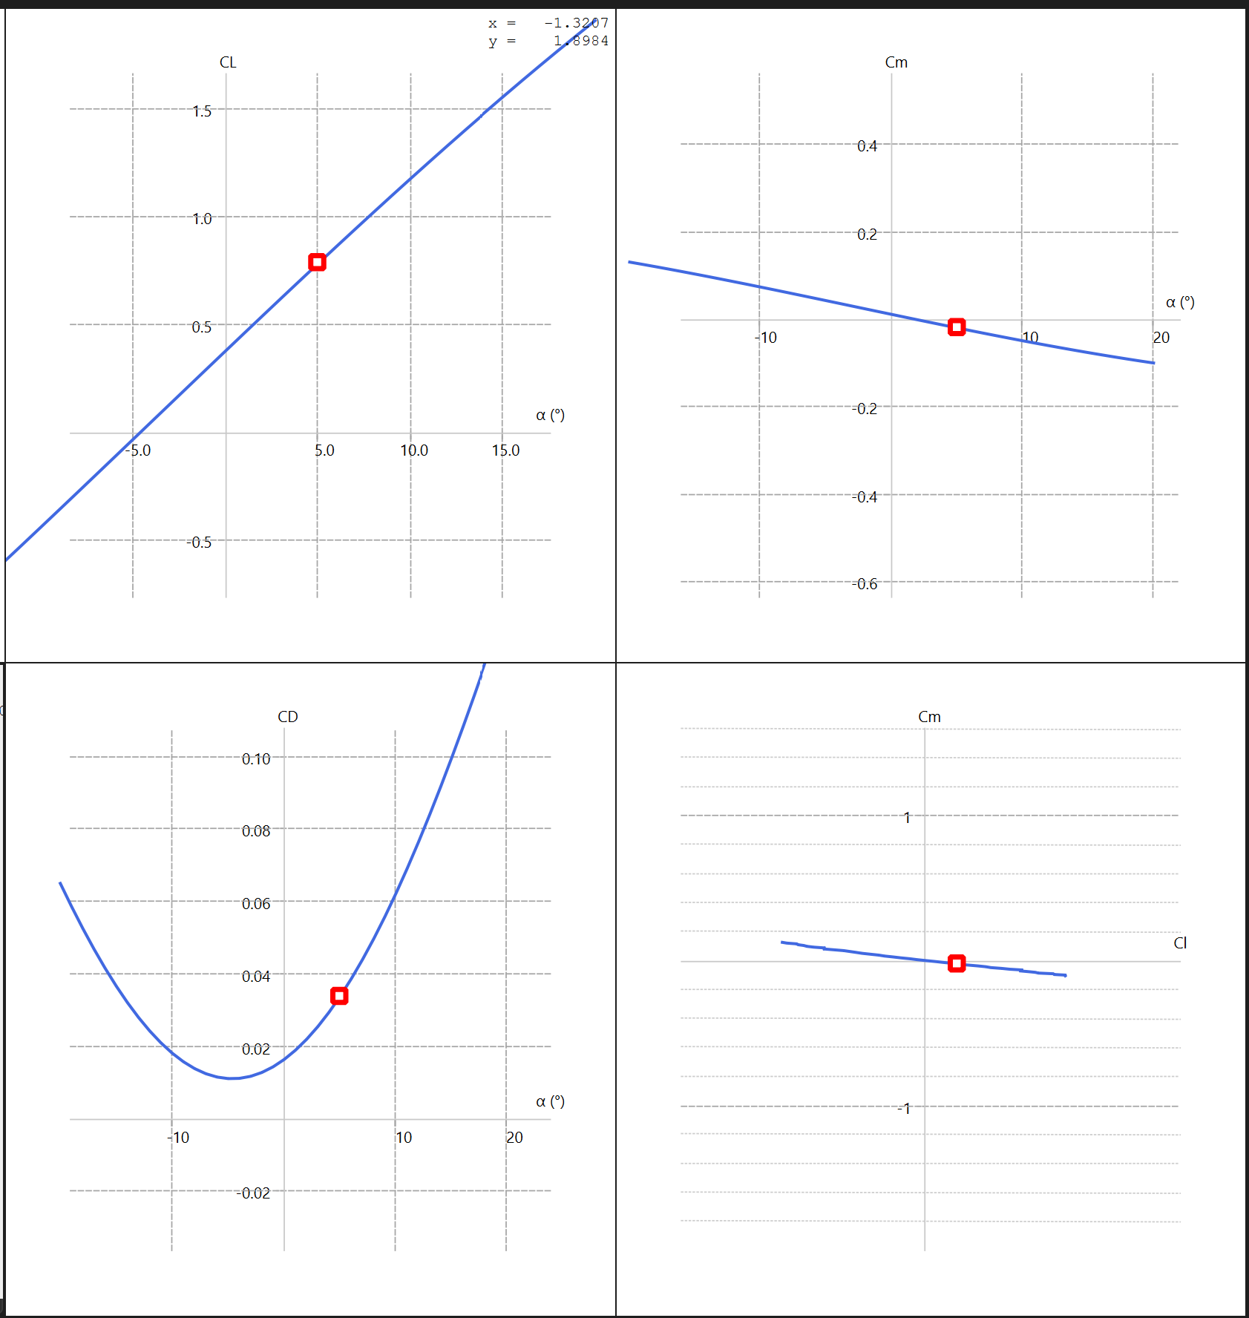
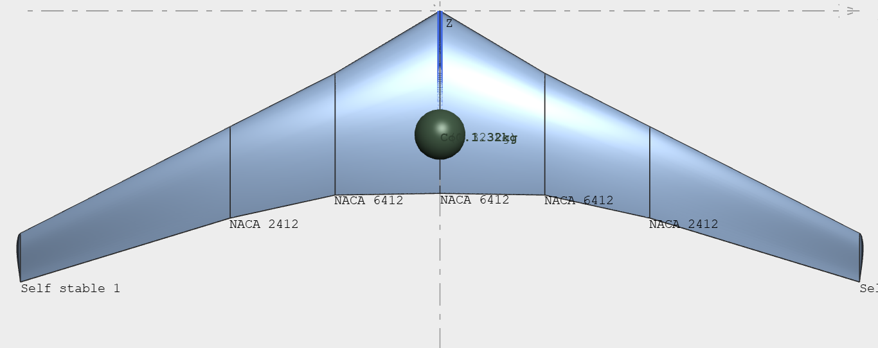
6412/6412/2412/SS 3/3/0/-5 cg: 0.1988
FINAL

Slide 3
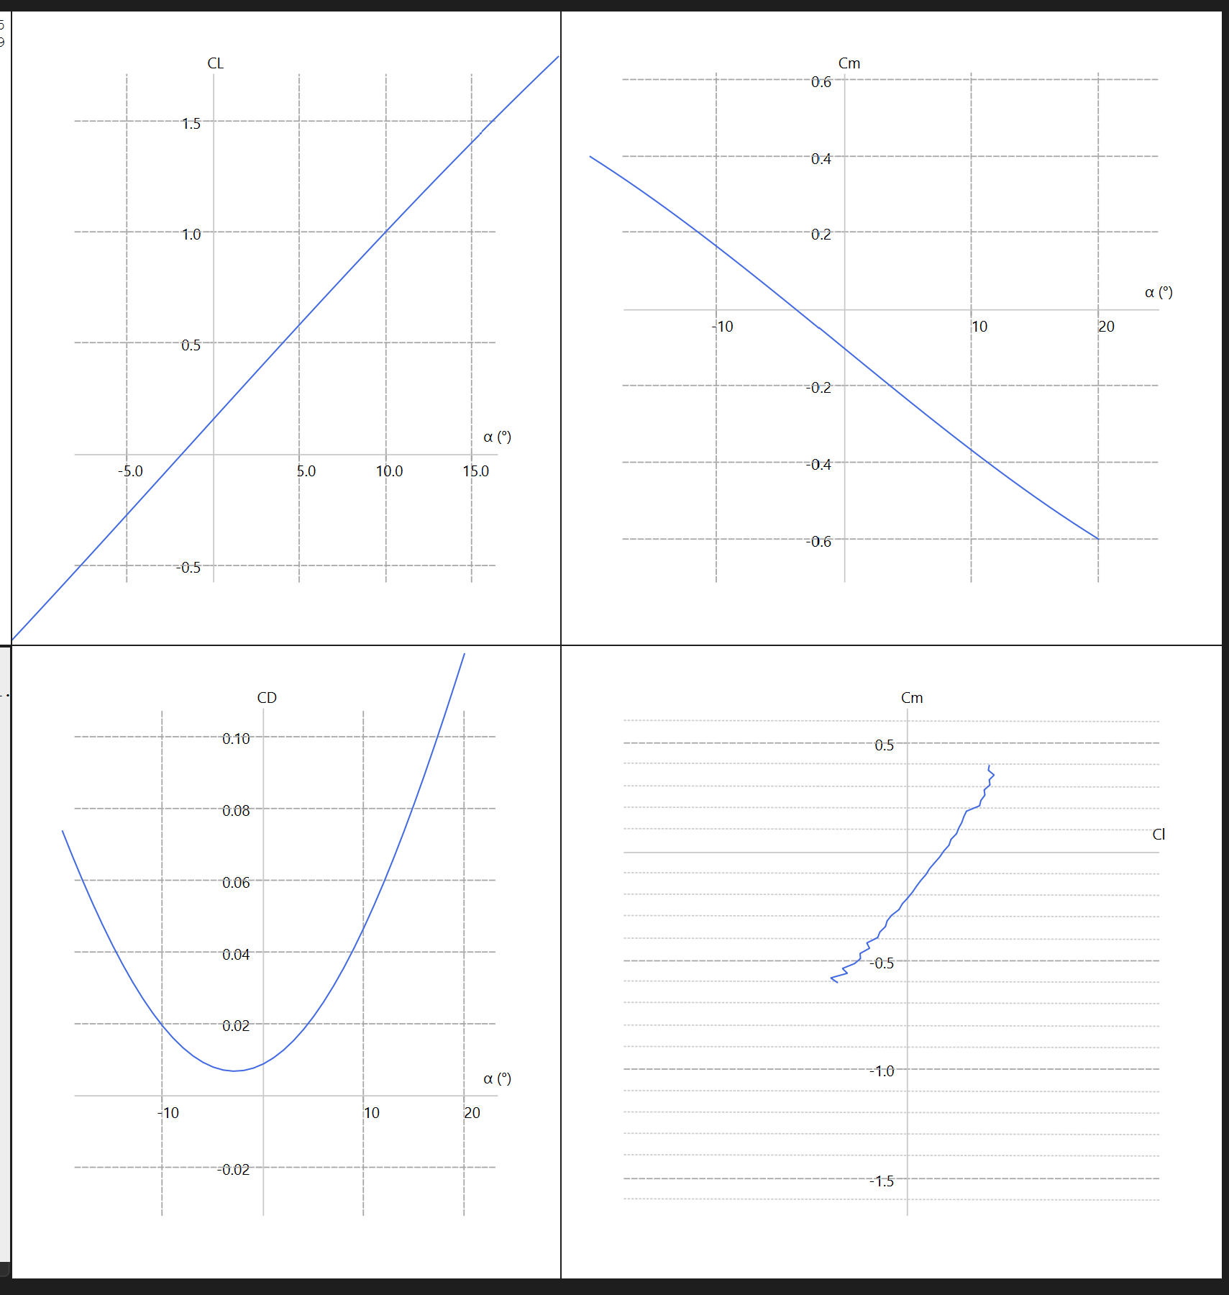
6412/2412/SS 0/-3/-3 cg: 0.08

Slide 4
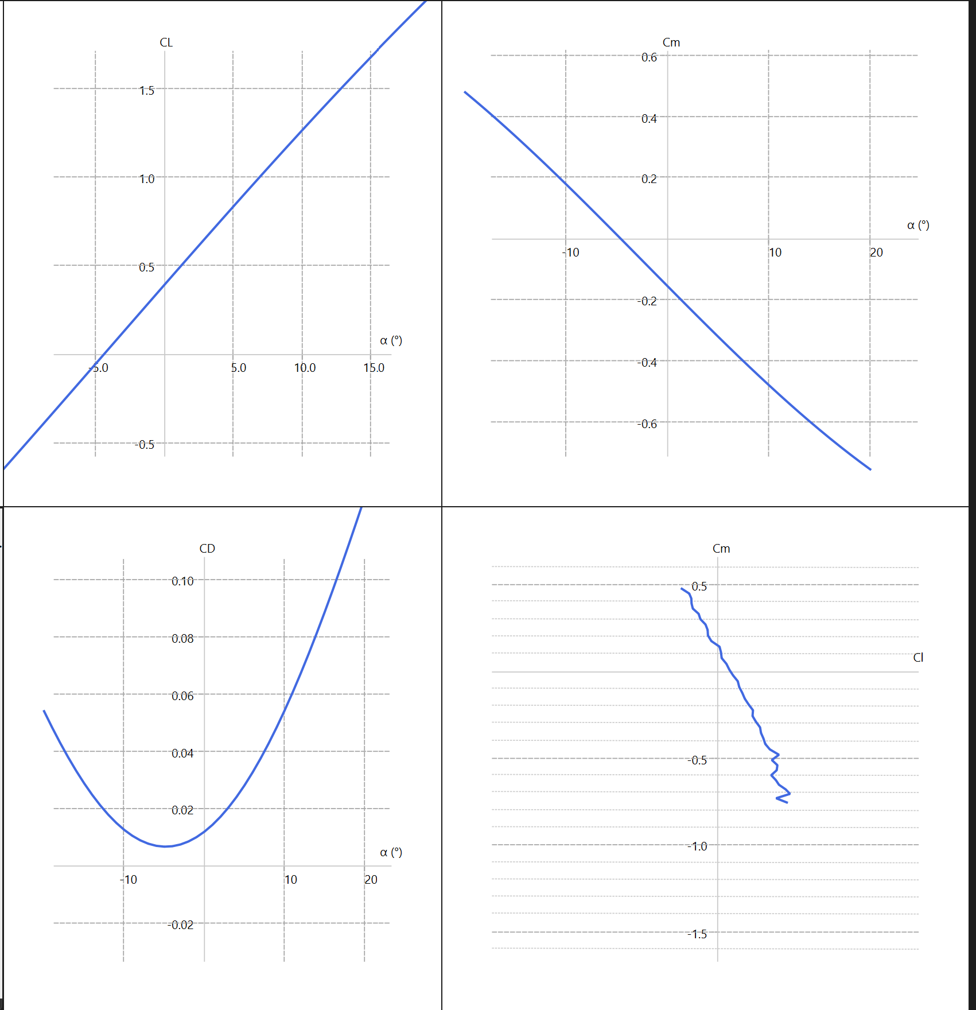
6412/2412/SS 3/0/0 cg: 0.08

Slide 5
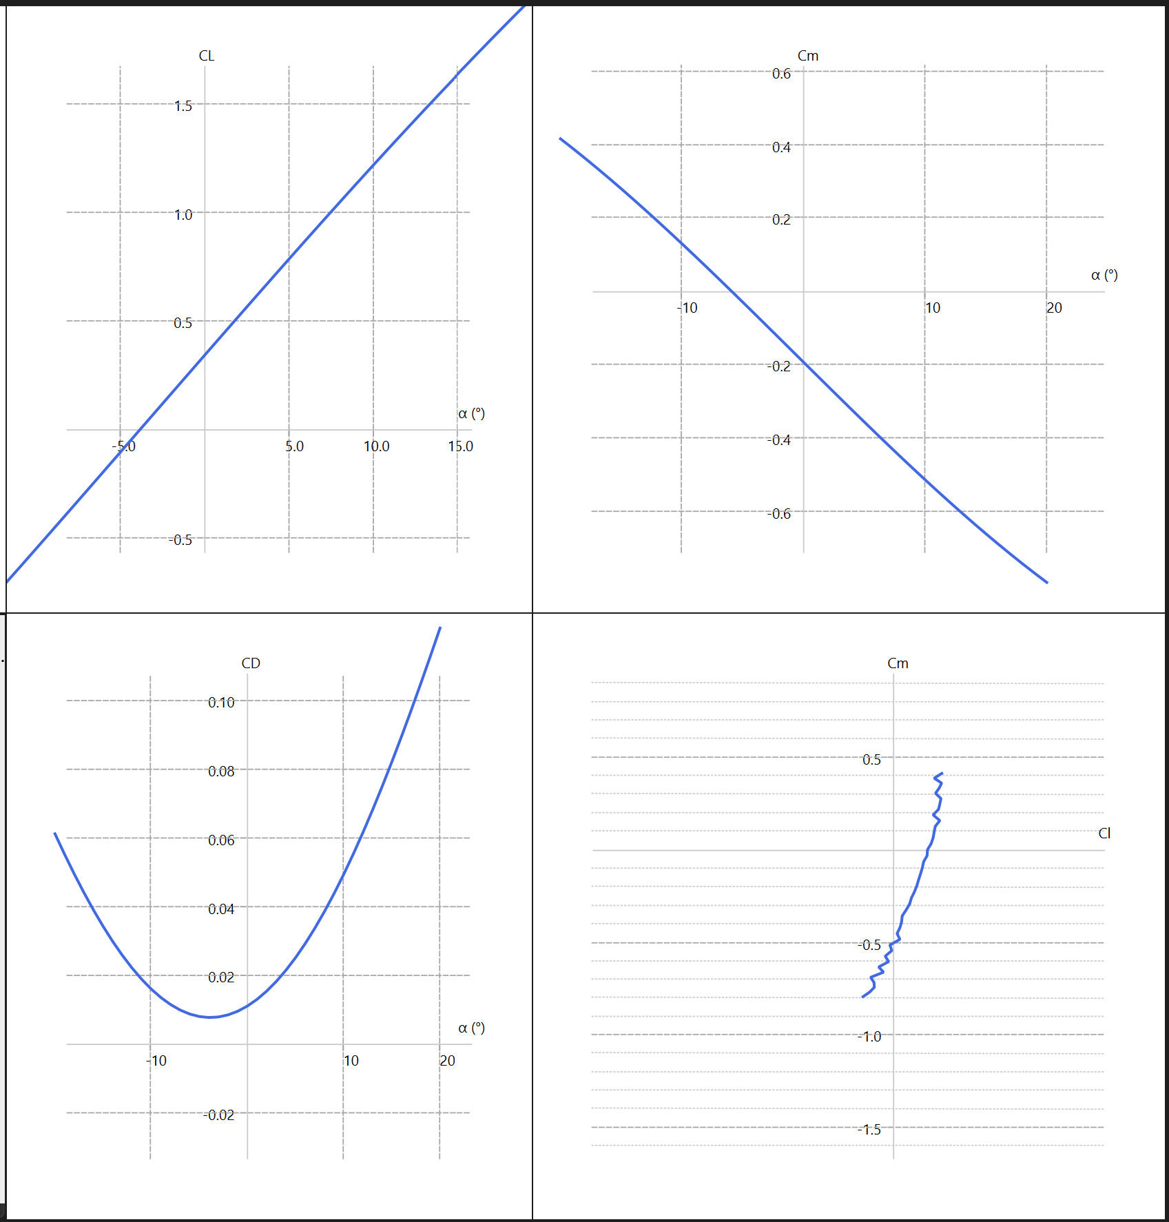
6412/6412/SS 0/0/-8 cg: 0.08

Slide 6
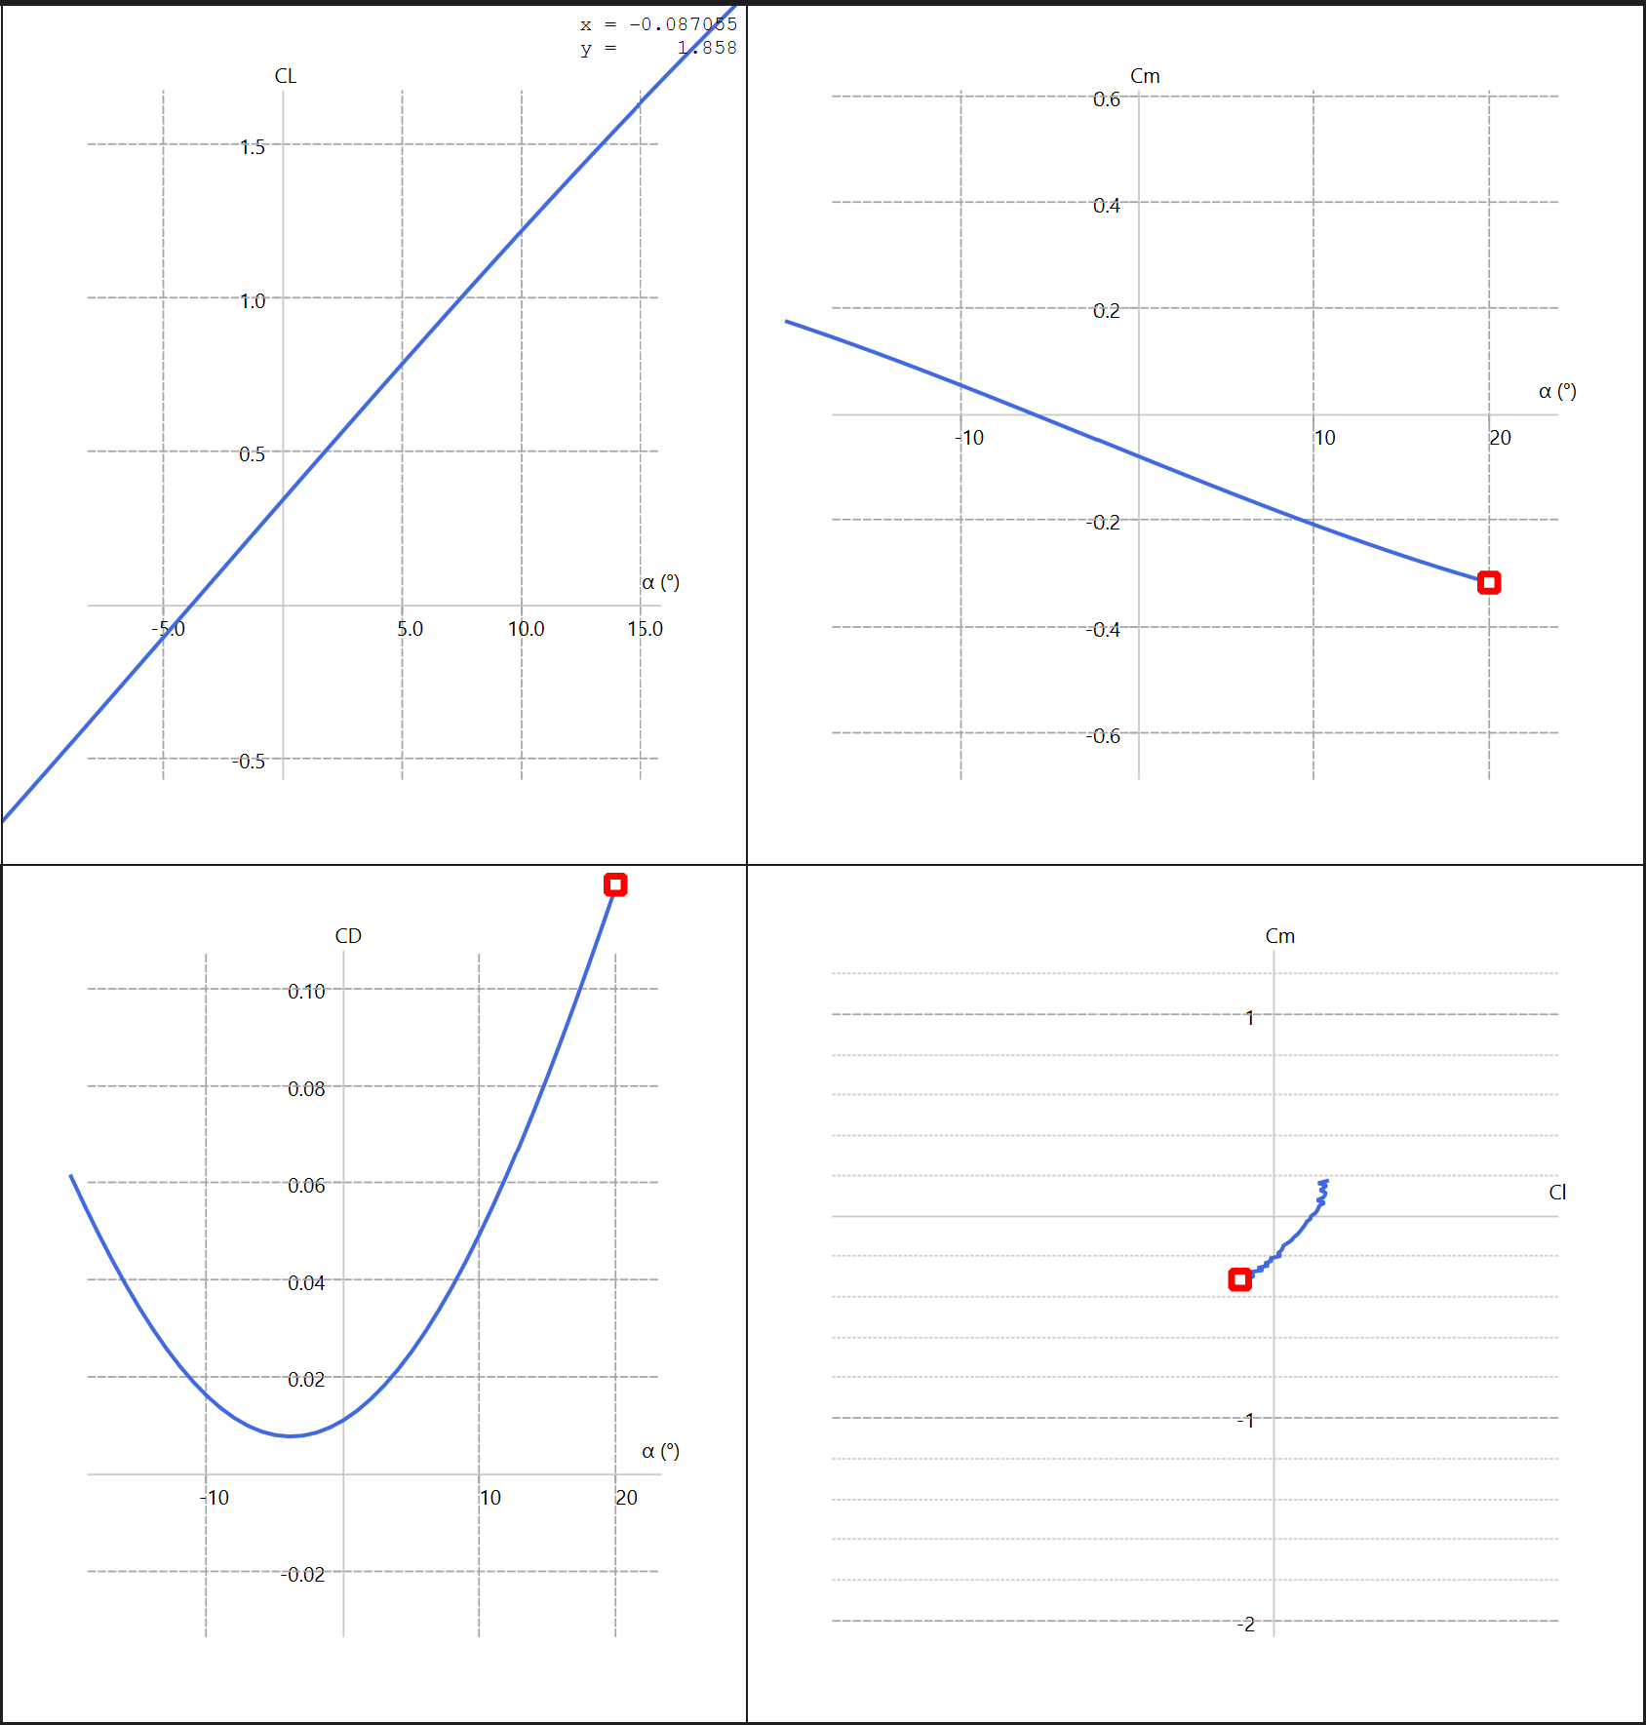
6412/6412/SS 0/0/-8 cg: 0.12

Slide 7
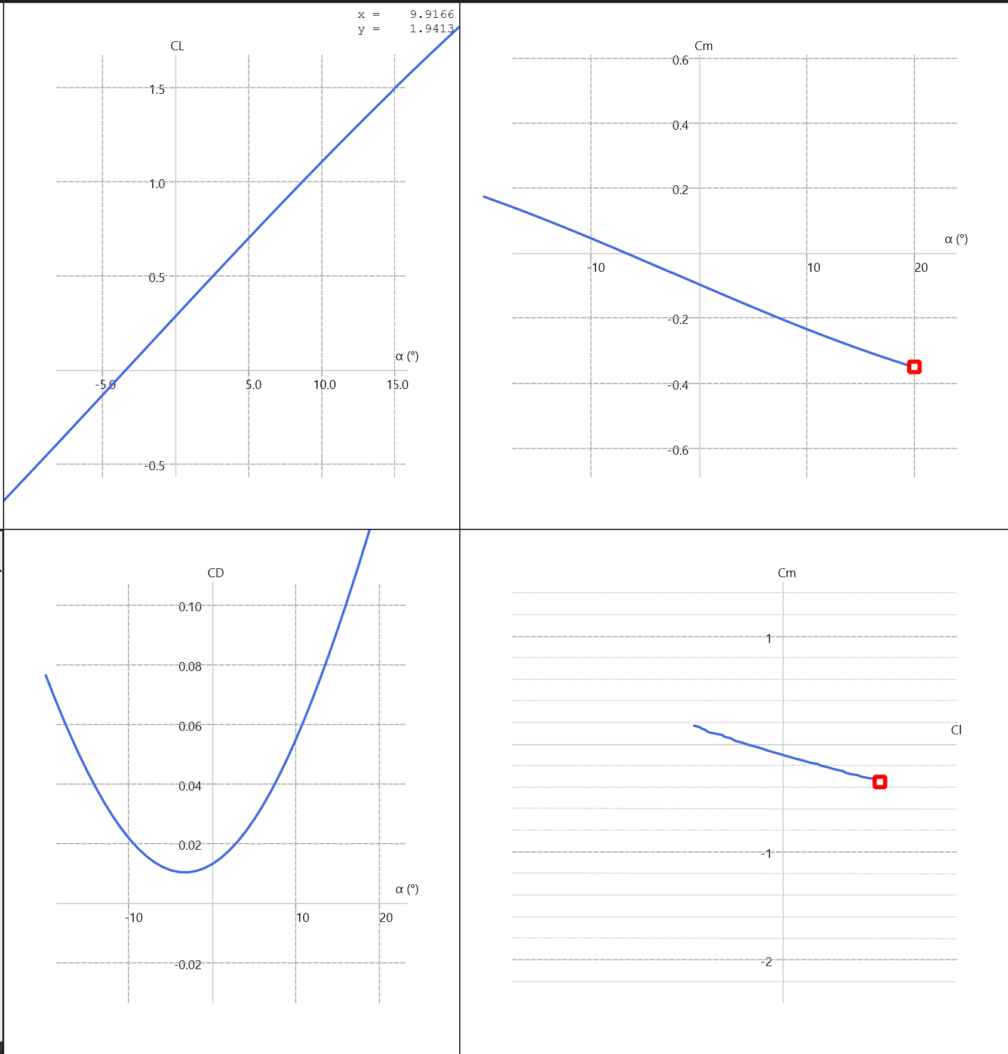
6412/6412/SS 3/3/-8 cg: 0.12
Thicker wing
AR ~ 8
Prev AR ~ 11

Slide 8
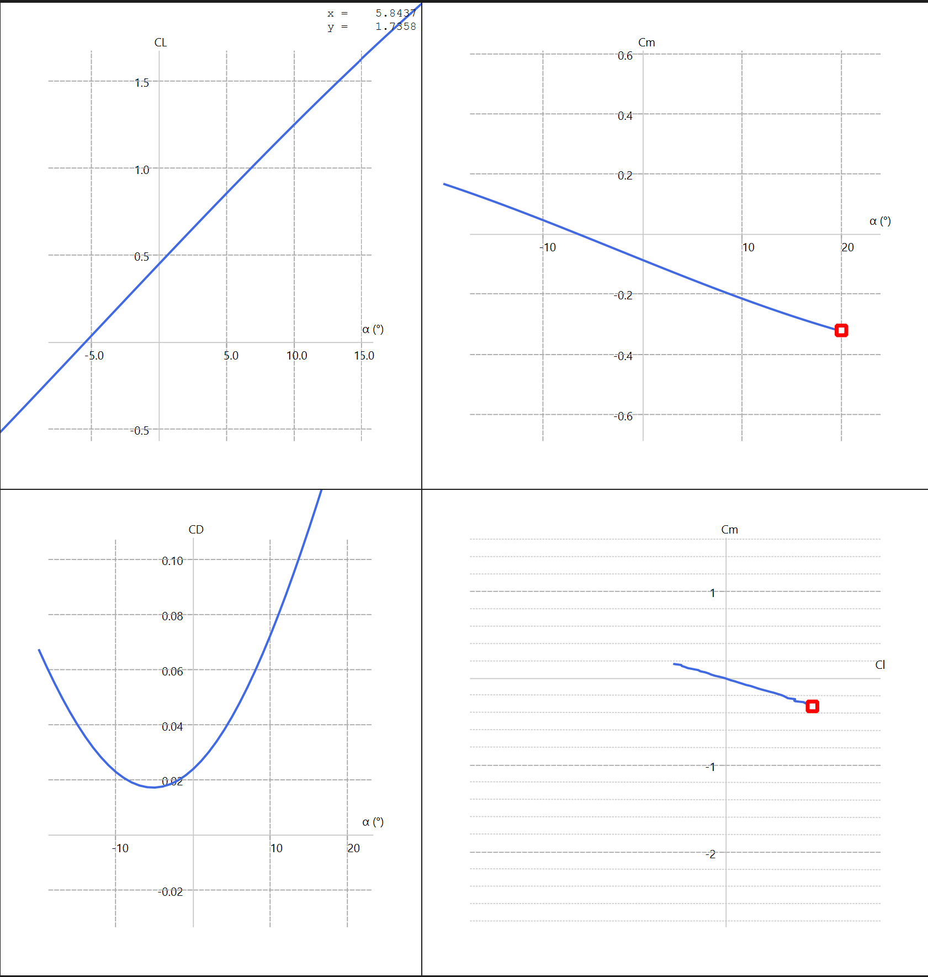
6412/6412/SS 3/3/-8 cg: 0.12
Made tips thicker

Slide 9
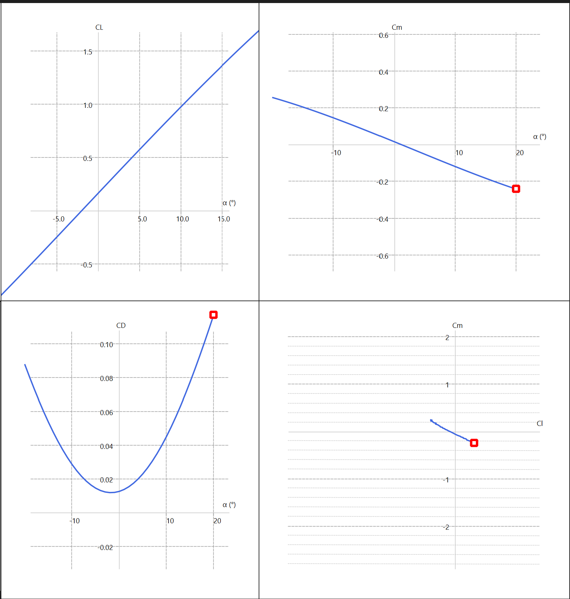
2412/2412/SS 3/3/-8 cg: 0.12

Slide 10
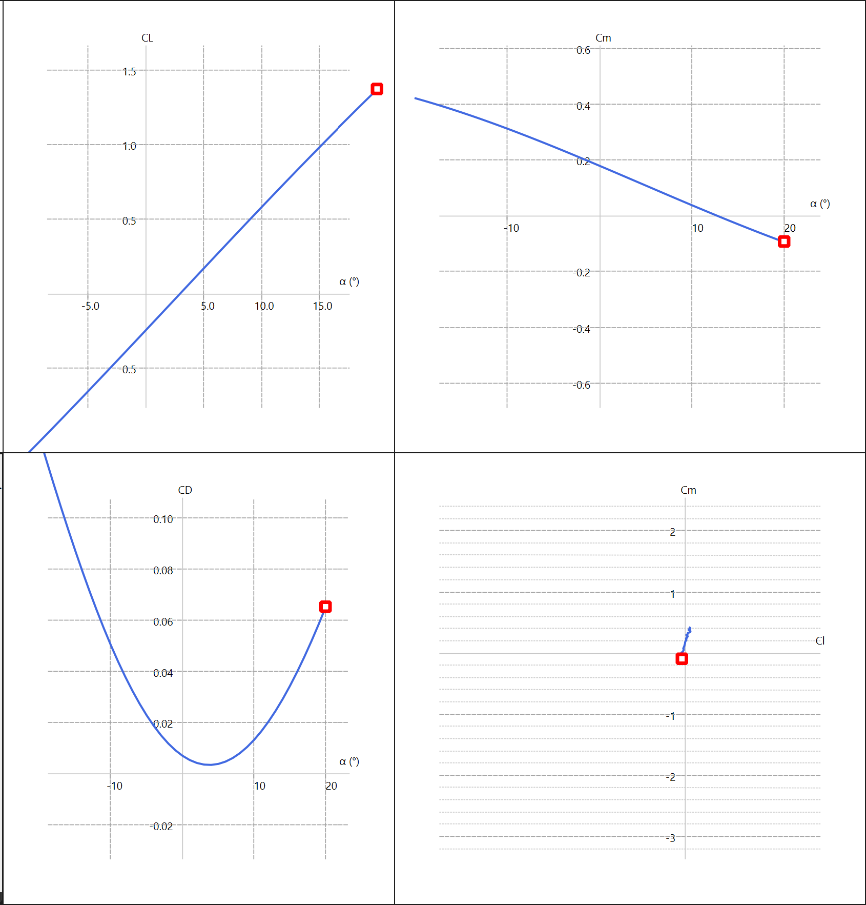
SS3/0012/SS 3/3/-2 cg: 0.12
SS3 is derived from 6412 with a highly reflexed trailing edge

Slide 11
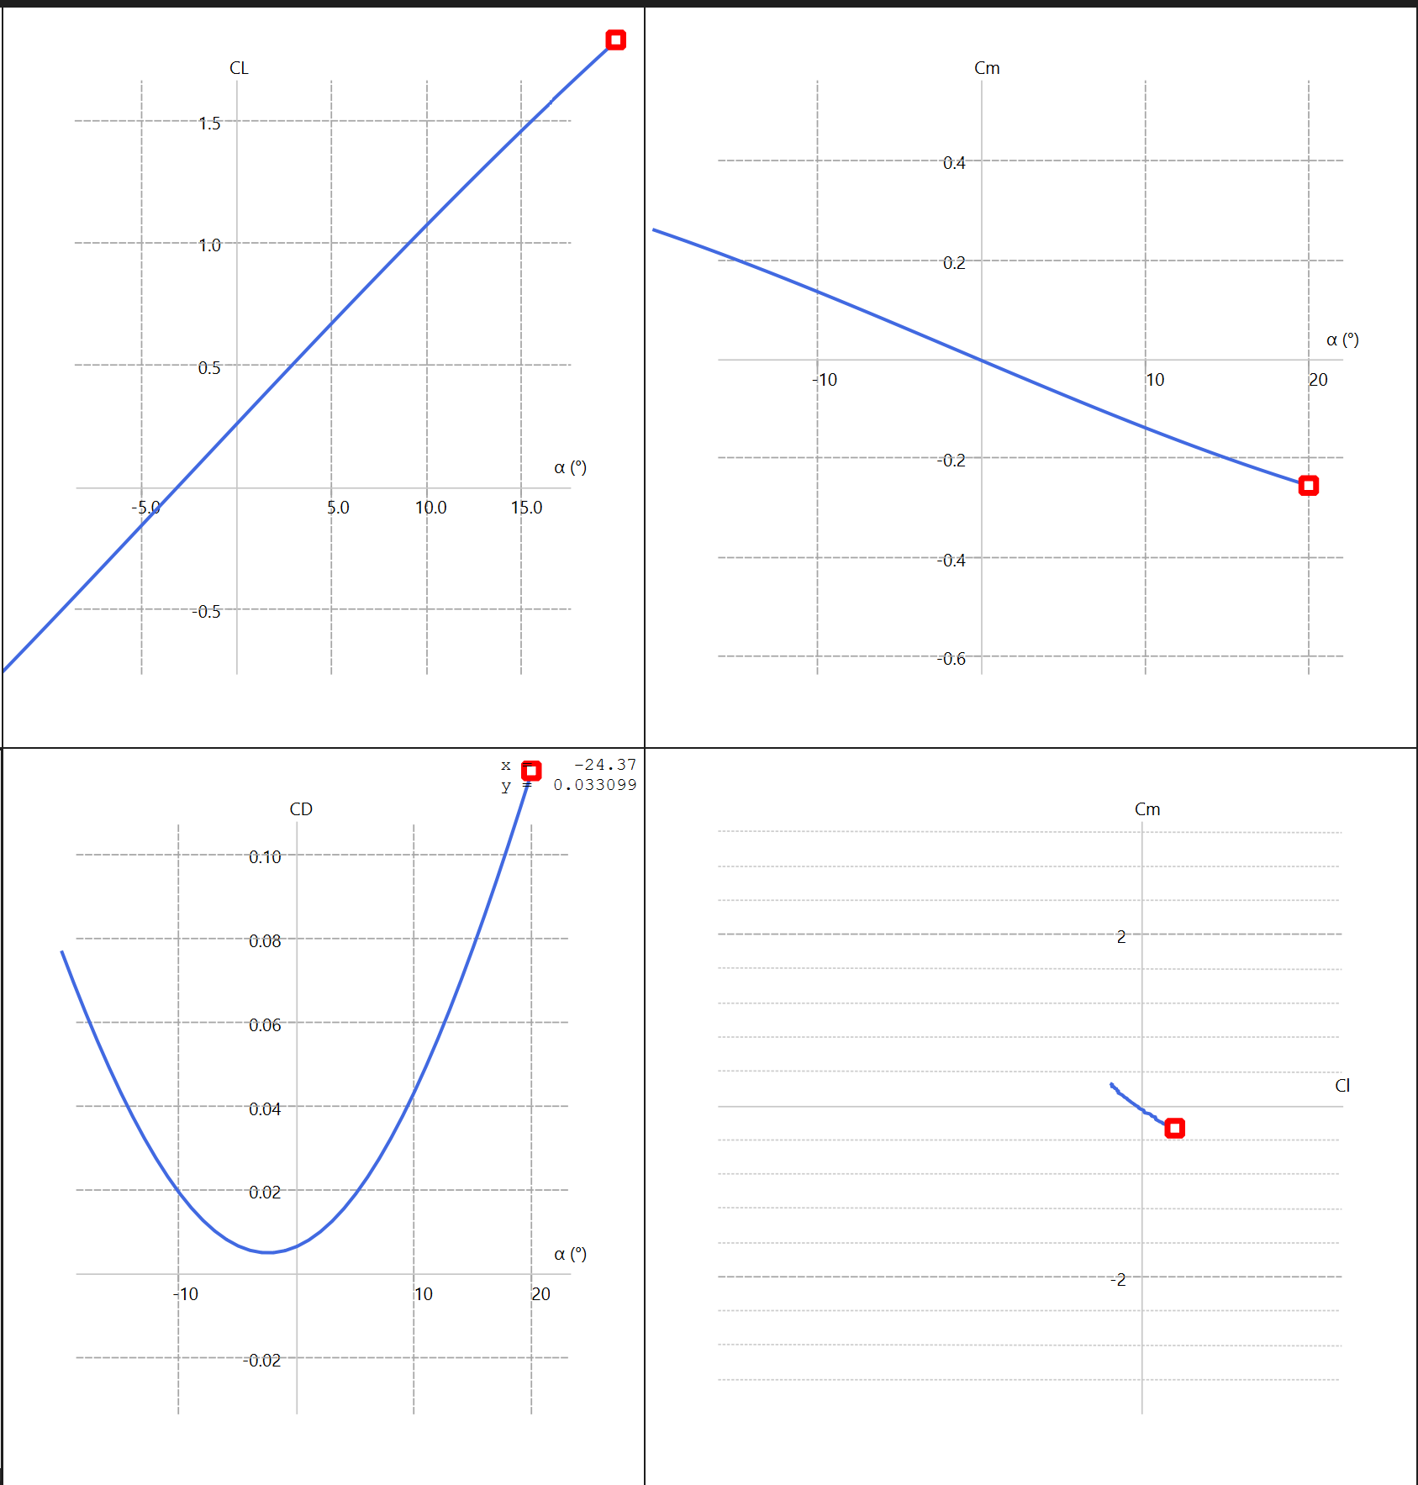
SS4/6412/SS 3/3/-2 CG: 0.12
SS4 is a less reflexed version of SS3

Slide 12
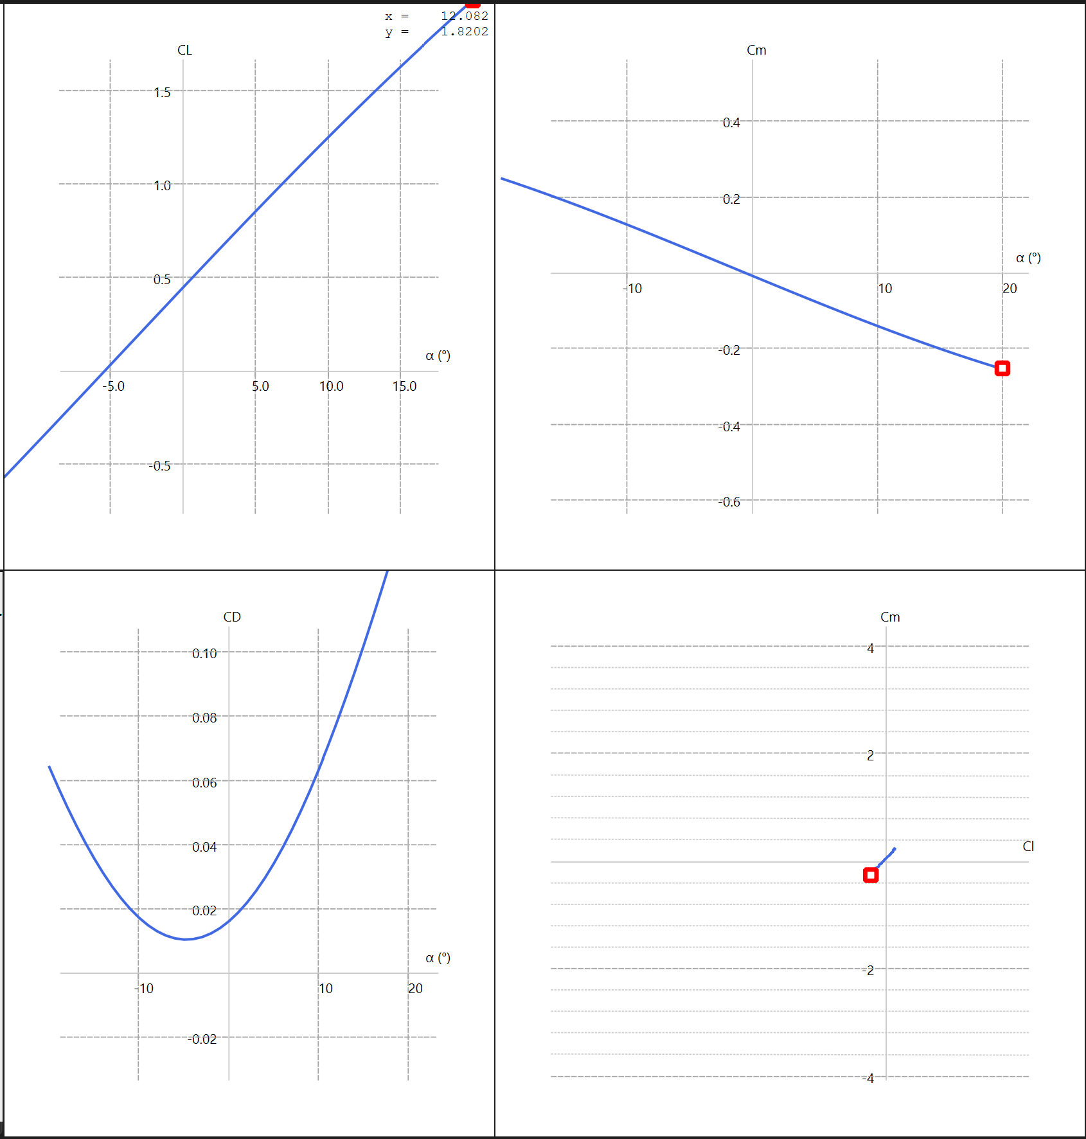
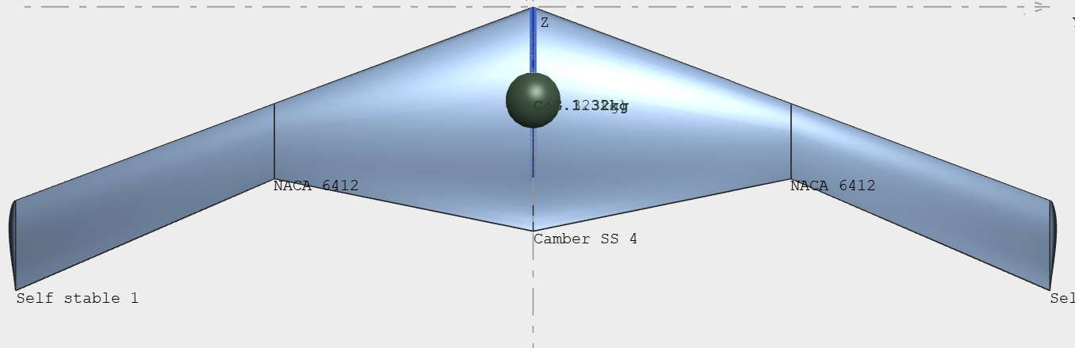
SS4/6412/SS 7/5/-5 CG:0.12

Slide 13
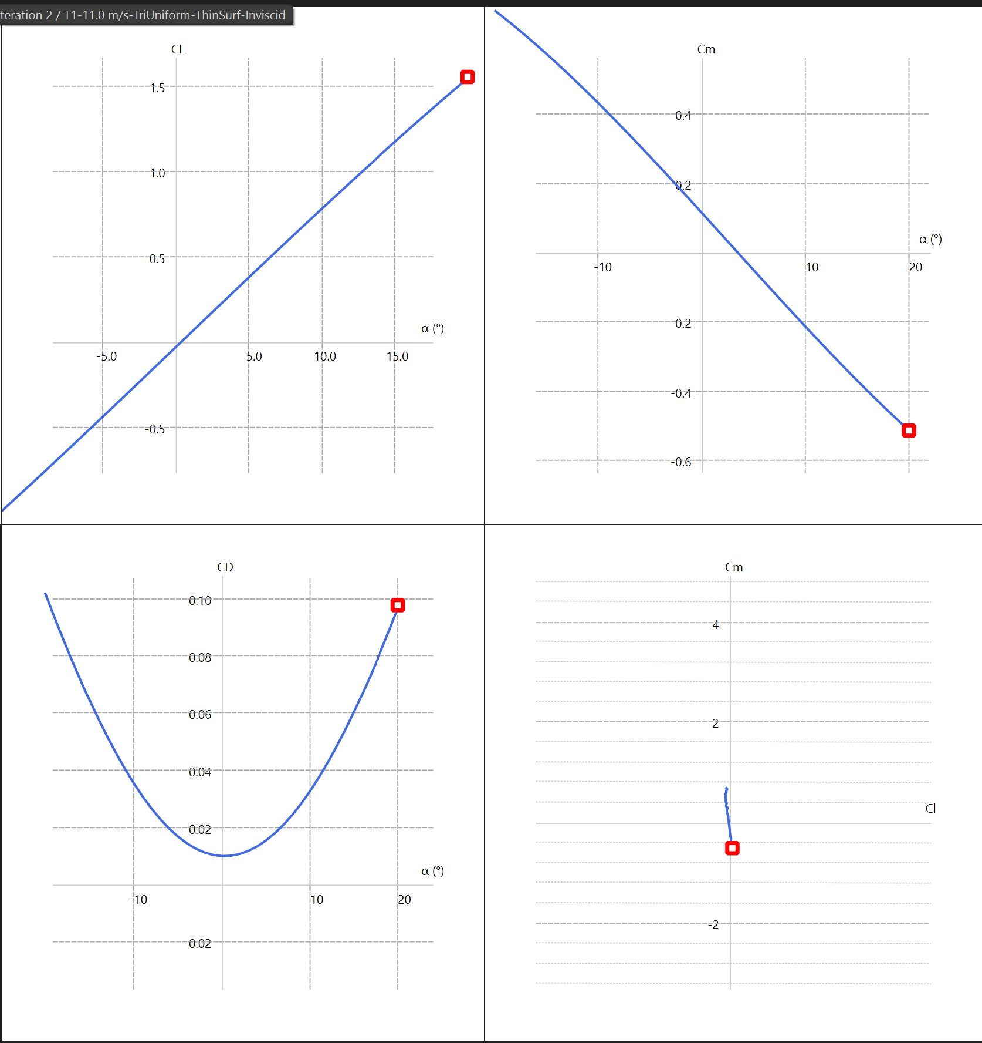
SS4/6412/SS/SS 3/0/2/-5 cg:0.12
Increased sweep to 25 degrees
AR ~ 8.4

Slide 14
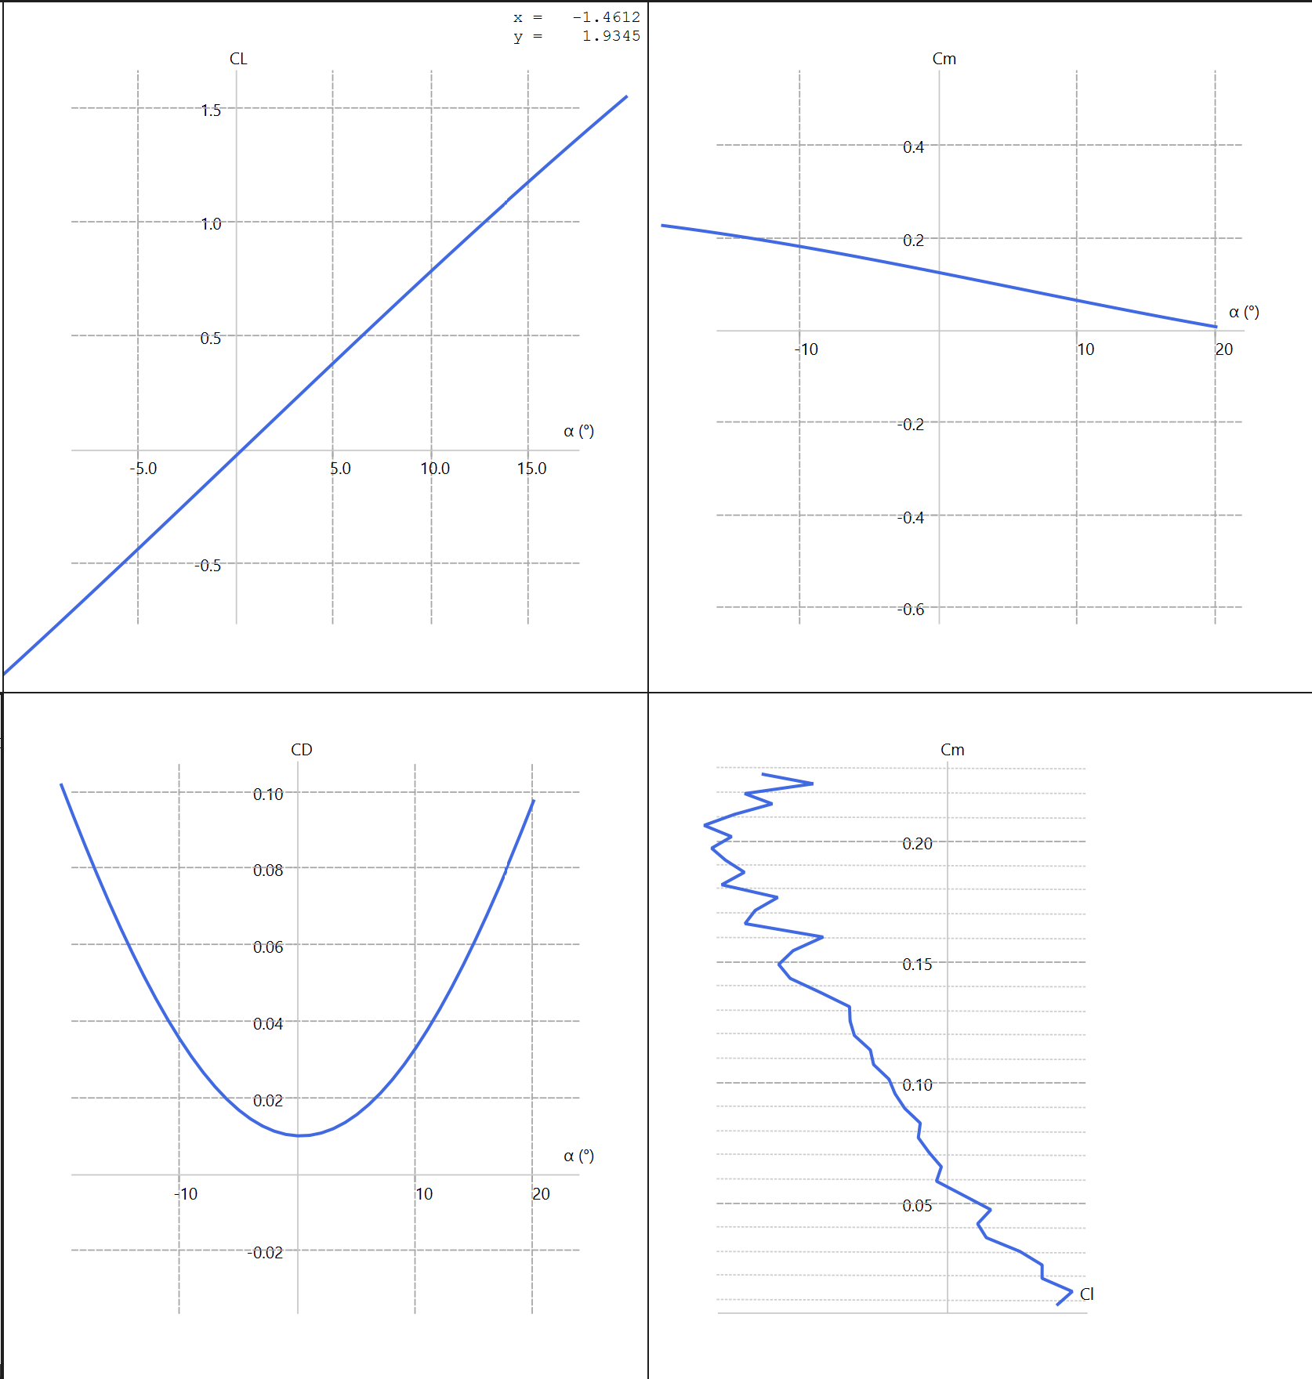
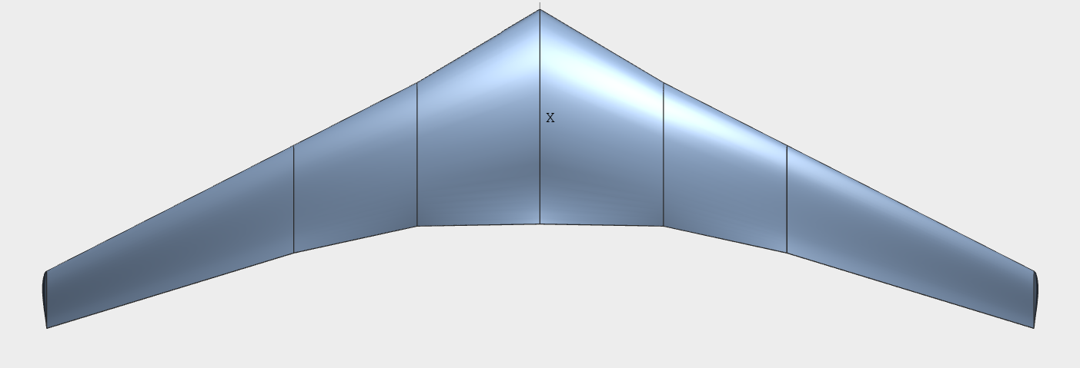
SS4/6412/SS 7/5/-5 CG:0.2

Slide 15
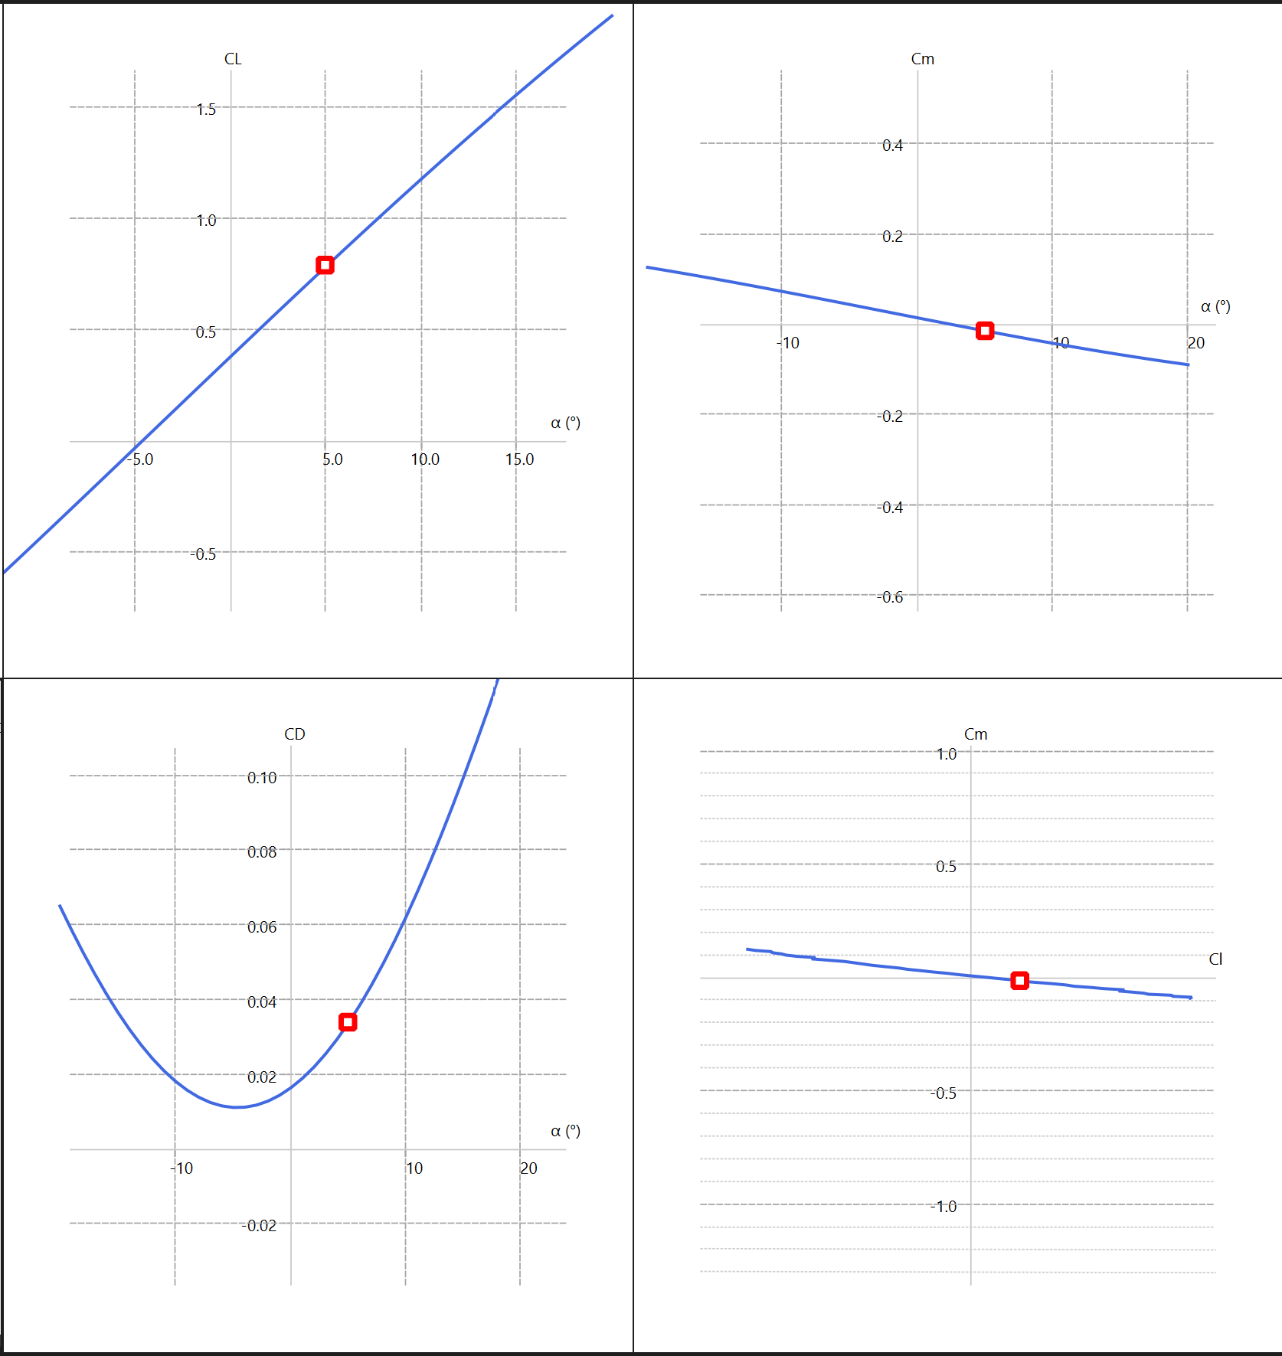
6412/6412/2412/SS 3/3/0/-5 cg: 0.2

